Slide 1
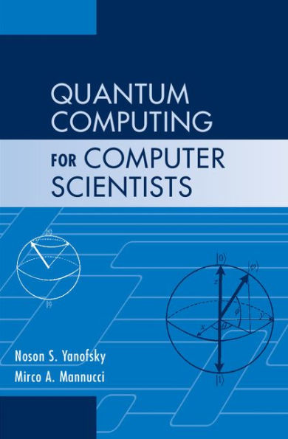
Grover’s Algorithm
Slides prepared by Dr. Leon Deligiannidis
These slides are based from the book:
Noson S. Yanofsky, Mirco A. Mannucci, “Quantum Computing for Computer Scientists”. Cambridge University Press ISBN 987-0-521-87996-5

Slide 2
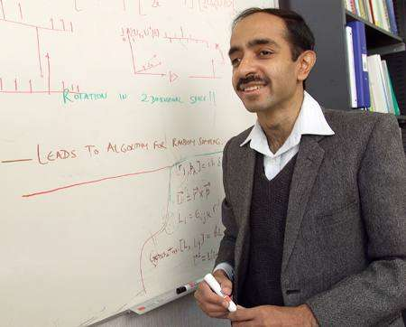
Lov K. Grover
Grover's algorithm is a quantum algorithm for searching an unsorted database with N entries in O(N^{1/2}) time and using O(log N) storage space.
Lov K. Grover. “A fast quantum mechanical algorithm for database search”. Proceedings, 28th Annual ACM Symposium on the Theory of Computing (STOC), May 1996, pages 212-219.

Slide 3
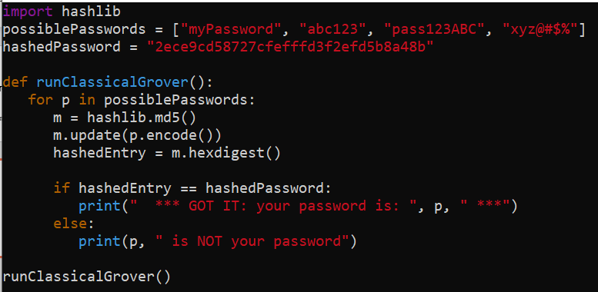
How do you find a needle in a haystack? You look at each piece of hay separately and check each one to see if it is the desired needle. That is not very efficient.
Given an unordered array of m elements, find a particular element. Classically, in the worst case, this takes m queries. On average, we will find the desired element in m/2 queries. Can we do better?
Lov Grover’s search algorithm does the job in sqrt(m) queries.
Classical version of Grover’s Algorithm. Example python3 code.

Slide 4
Grovers algorithm
Instead of checking all the possibilities one after the other, it creates a uniform superposition over all possibilities. It then repeatedly interferes destructively with the states that are not solutions and interferes constructively with the state that is a solution.
Grover’s algorithm doesn’t search through a list of elements (like a database). Instead, it searches through function inputs. The function returns true for just “one” specific input and that’s the specific input that Grovers algorithm finds.
(for multiple input solutions, a variant of this algorithm needs to be implemented)

Slide 5
Breaking symmetric cryptosystems
Grover's algorithm could also be used to break certain cryptography methods such as Advanced Encryption Standard (AES), which is used by many (such as WinRaR).
AES uses keys with a length of 128, 192 and 256 bits.
With Grover’s algorithm, a 256 bit key can be found in 'only' 2¹²⁸ iterations. That is still an enormous number, however it is almost 10⁴⁰ times faster compared to brute forcing!
If large quantum computers become available, AES users would be advised to use keys with more than 256 bits.
Public-key (RSA, DH, ECDH): Broken by Shor’s algorithm
Modes of operation (GCM,CBC-MAC) Broken by Simon’s algorithm
Block Ciphers (AES, DES): Attacks improved by Grover’s algorithm
Hash Functions (SHA2): Attaches improved by Grover’s algorithm
Password hashing (PBKDF2, scrypt): Broken by Grover’s algorithm

Slide 6
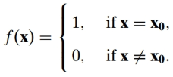
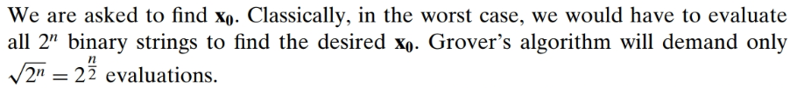
Imagine that you are given a function f : {0, 1}^{n} → {0, 1} and you are assured that there exists exactly one binary string x₀ such that:

Slide 7
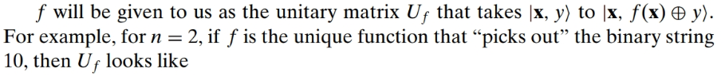
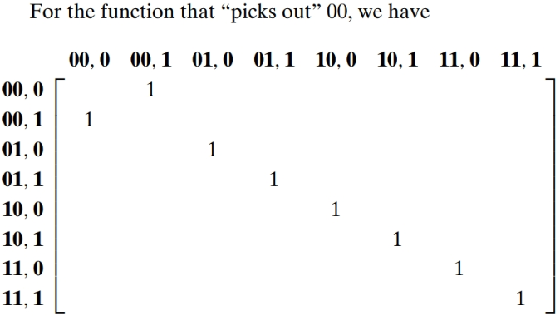
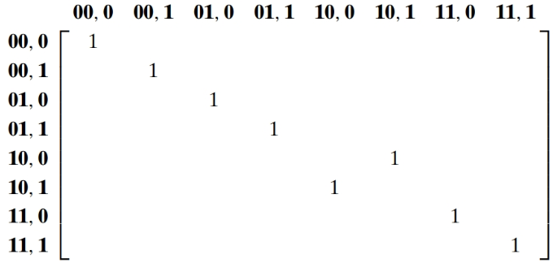
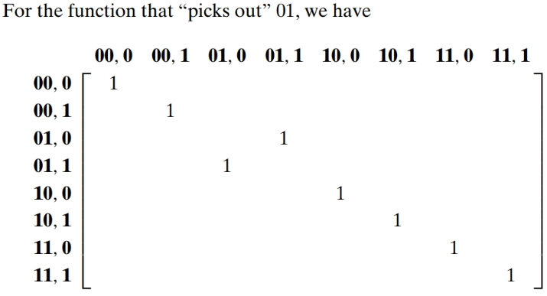
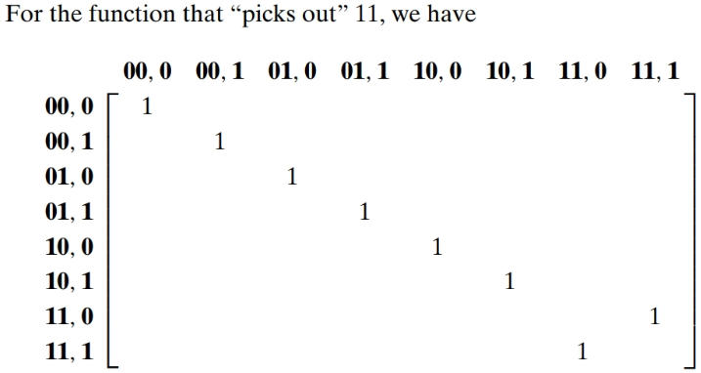
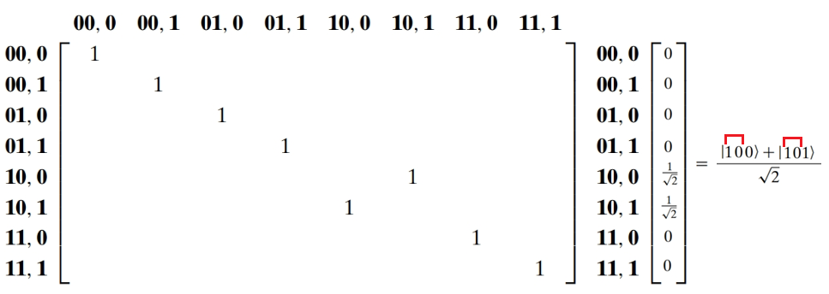
Output |x, f(x) ⊕ y⟩
Input |x,y⟩
Input:
x=01
y=0
(01,0)
Output:
x=01
f(x) ⊕ y = 0 ⊕ 0 = 0
(01,0)
Input:
x=01
y=1
(01,1)
Output:
x=01
f(x) ⊕ y = 0 ⊕ 1 = 1
(01,1)
Input:
x=10
y=0
(10,0)
Output:
x=10
f(x) ⊕ y = 1 ⊕ 0 = 1
(10,1)

Slide 8
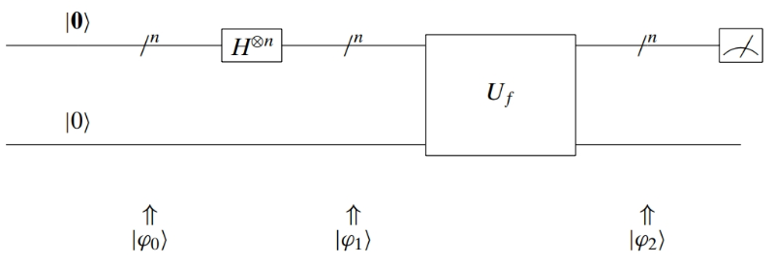
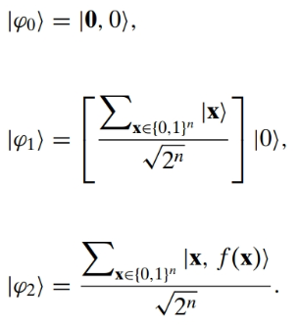
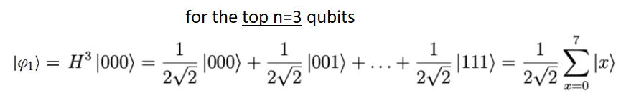
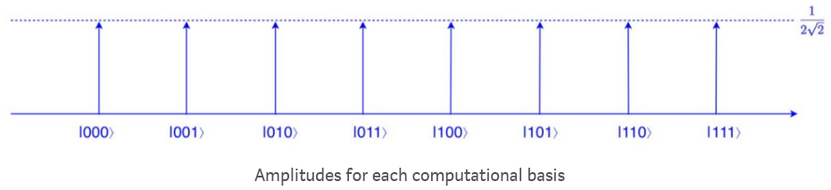
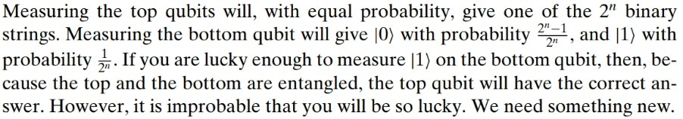
Let’s Try

Slide 9
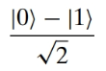
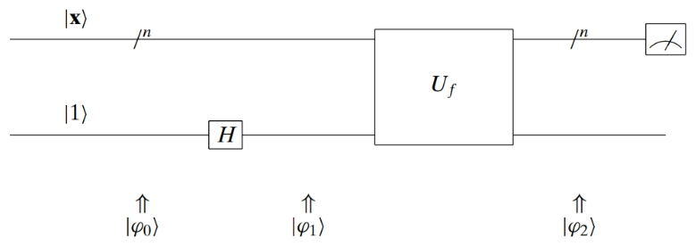
Phase Inversion
Grover’s search algorithm uses two tricks. The first, called phase inversion, changes the phase of the desired state. It works as follows. Take U_{f} and place the bottom qubit in the superposition state.
Trick: use phase-kickback that flips the phase of the marked (by the Oracle) in the data qubits.

Slide 10
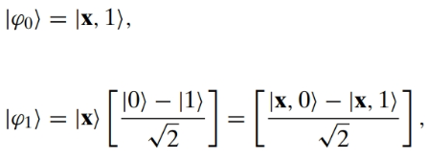
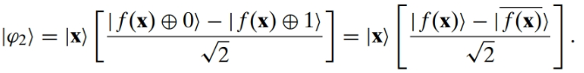
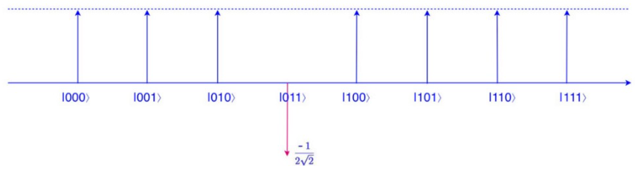
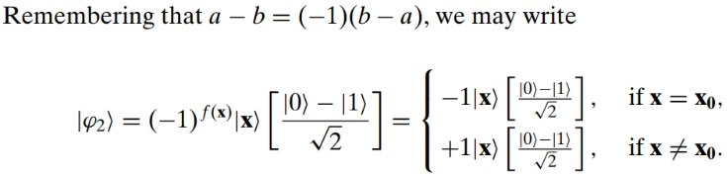
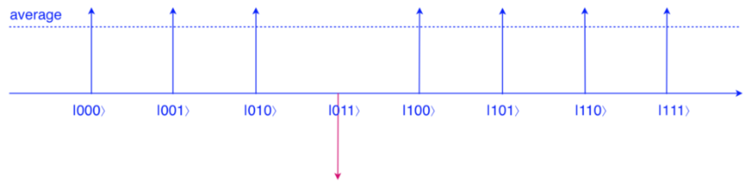
So for any |x⟩ with f(x) = 0, its amplitude does not change. Otherwise, the amplitude is changed to negative. For example, if f(011) =1 and after applying the Oracle function, the superposition state turns into:
The average of the amplitudes (the dotted line) will drop because of the negative amplitude of |011⟩.
if f(x)=1
if f(x)=0

Slide 11
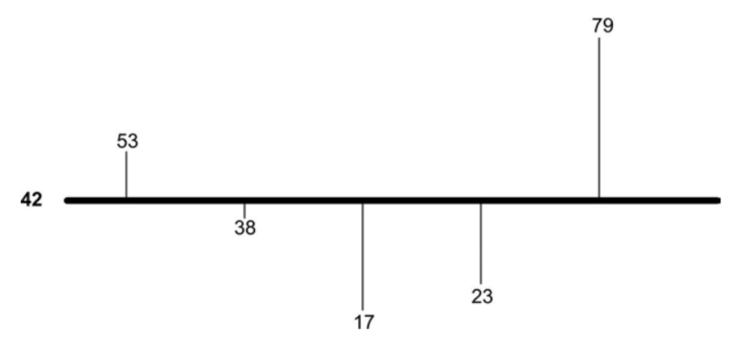
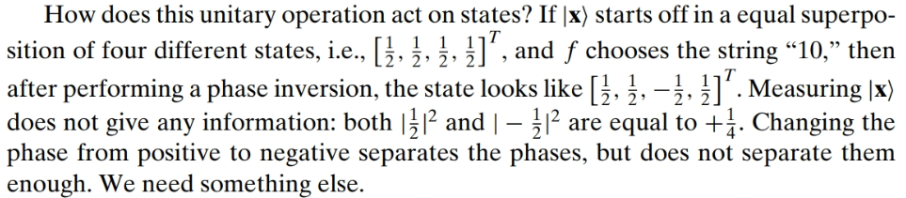
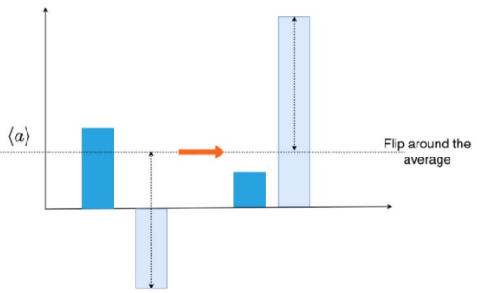
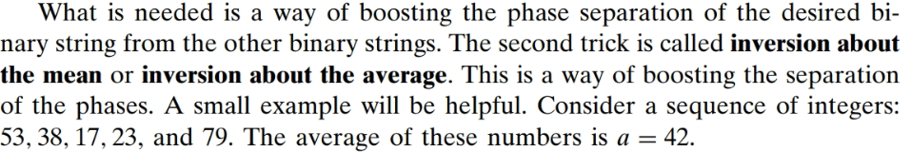
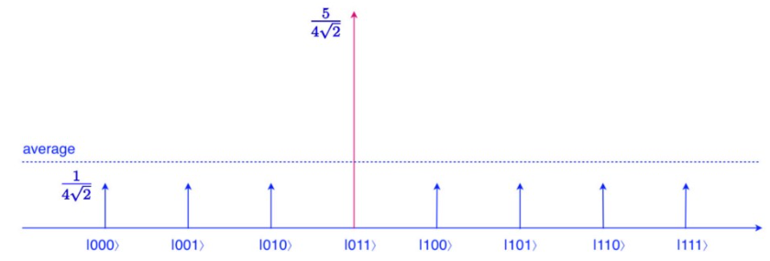
Inversion About the Mean

Slide 12
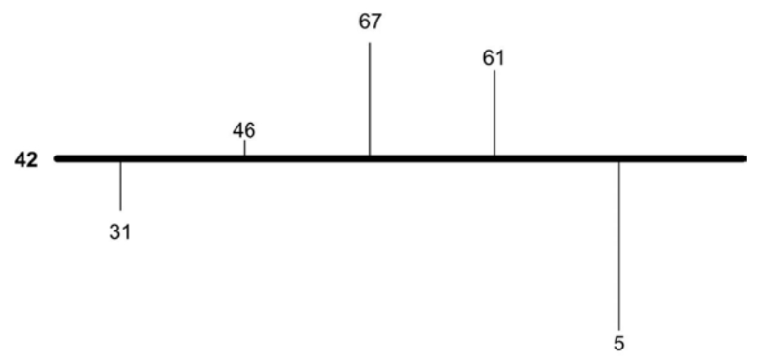
The average is the number such that the sum of the lengths of the lines above the average is the same as the sum of the lengths of the lines below.
Suppose we wanted to change the sequence so that each element of the original sequence above the average would be the same distance from the average but below.
Furthermore, each element of the original sequence below the average would be the same distance from the average but above. In other words, we are inverting each element around the average. For example, the first number, 53 is a − 53 = −11 units away from the average. We must add a = 42 to −11 and get a + (a − 53) = 31. The second element of the original sequence, 38, is a − 38 = 4 units below the average and will go to a + (a − 38) = 46. In general, we shall change each element v to
The above sequence becomes 31, 46, 67, 61, and 5. Notice that the average of this sequence remains 42

Slide 13
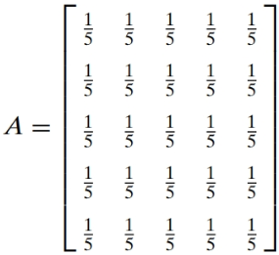
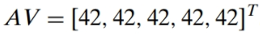
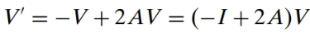
Let us write this in terms of matrices. Rather than writing the numbers as a sequence, consider a vector V = [53, 38, 17, 23, 79]^{T} . Now consider the matrix A
It is easy to see that A is a matrix that finds the average of a sequence:
In terms of matrices, the formula v′ = −v + 2a becomes

Slide 14
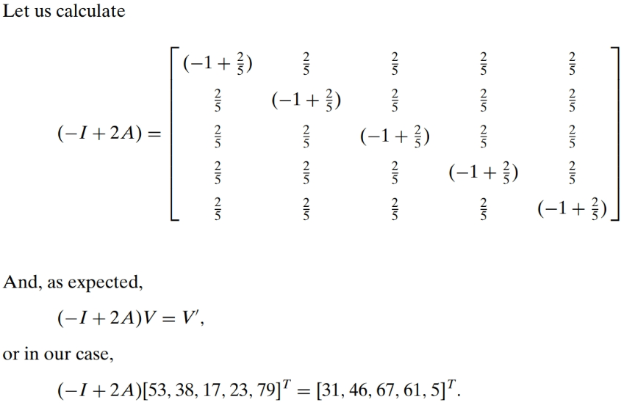

Slide 15
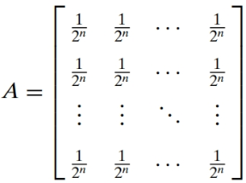
Let us generalize: rather than dealing with five numbers, let us deal with 2^{n} numbers. Given n qubits, there are 2^{n} possible states. A state is a 2^{n} vector. Consider the following 2^{n} -by- 2^{n} matrix:

Slide 16
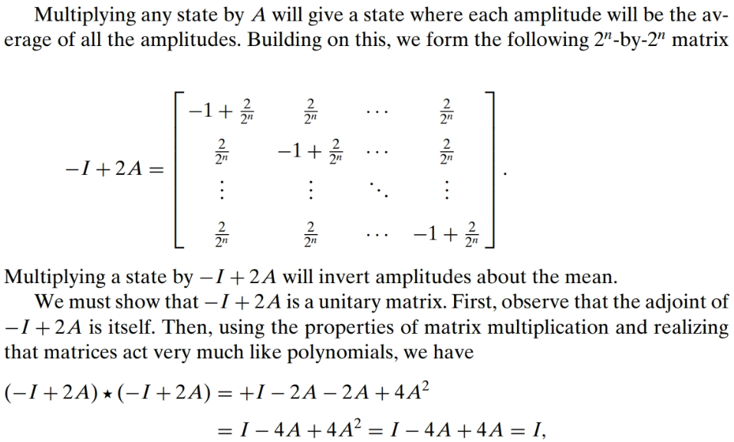
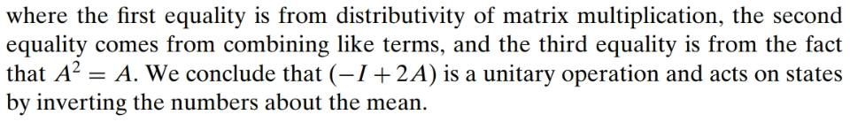
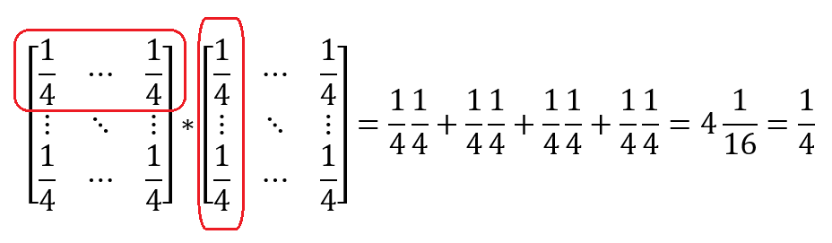
When considered separately, phase inversion and inversion about the mean are each innocuous operations.
However, when combined, they are a very powerful operation that separates the amplitude of the desired state from those of all the other states.
For n=2, shown only first element

Slide 17
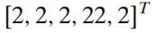
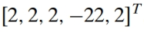
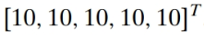
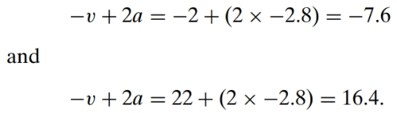
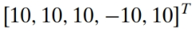
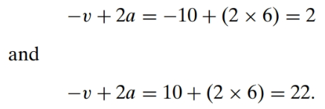
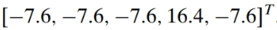
An Example
Thus, our five numbers become
The difference between the fourth element and all the others is 22 − 2 = 20. Let us do these two operations again to our five numbers. Another phase inversion on the fourth element gives us
Let us do an example that shows how both these techniques work together. Consider the vector
The average of these numbers is a = −2.8. Calculating the inversion about the mean we get
We are always going to perform a phase inversion to the fourth of the five numbers. There is no difference between the fourth number and all the other numbers. We start by doing a phase inversion to the fourth number and get
The average of these five numbers is a = 6. Calculating the inversion about the mean we get
Hence, our five numbers become
The difference between the fourth element and all the others is 16.4 + 7.6 = 24. We have further separated the numbers. This was all done with unitary operations.

Slide 18
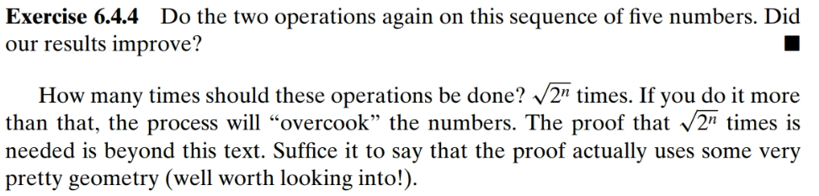
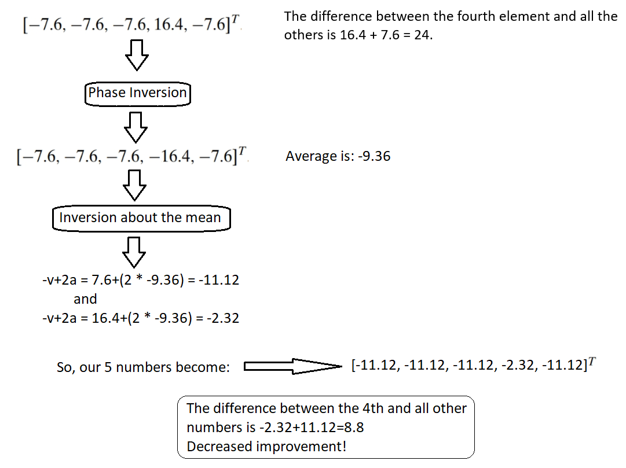

Slide 19
At first sight, you may think that Grover's algorithm does not seem too useful. You can find a certain quantum state, but only after you know some oracle function. But if you have the oracle function, is it not already clear what the outcome of the algorithm will be? In the case of searching through a database, you are absolutely right. However, there are some cases in which it is not readily clear from the oracle function what the outcome will be.
Consider for example the SHA256 algorithm, which is used for example as the proof of work algorithm in several cryptocurrencies. SHA256 is a one-way function that hashes the input that is given. As a result, the output looks completely random. The objective in proof of work is to find some input that results in a given output. Since it is a one-way function, the desired input cannot directly be deduced from the output. Using Grover’s algorithm, the outcome of all possible input states can be checked simultaneously. The algorithm then increases the amplitude of the input states that give the desired output.
That way, an appropriate input state can be found way quicker than by classical brute forcing.
Hint: Oracle for 0000000xxxxxxxxxxxxxxxxxxxxxxxxxxxxxxx where x is either 0 or 1 (proof of work!). The problem is to build the Oracle.
Hint: Salt in passwords + password = hashed password
Read: GroverOracles.pdf

Slide 20
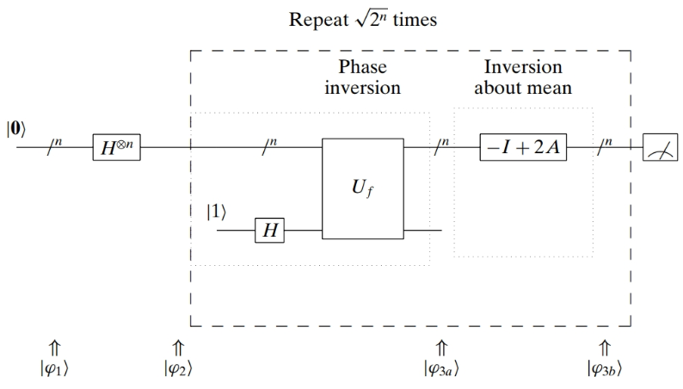
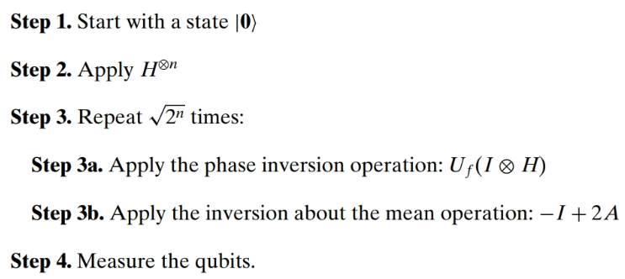
Grover’s algorithm

Slide 21
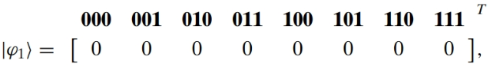
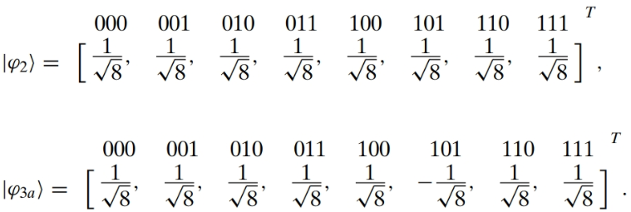

Let us look at an example of an execution of this algorithm. Let f be a function that picks out the string “101”. The states after each step will be:

Slide 22


Slide 23


Slide 24



Grover’s Quantum Circuit
It’s been proven that the optimum number of iterations is:

Slide 25


Code in ProjectQ
Two ProjectQ programs in python3.
002_grover.py
003_grover_circuit.py
The second program can be used to draw the circuit.

Slide 26

http://demonstrations.wolfram.com/QuantumCircuitImplementingGroversSearchAlgorithm/
Most significant bit
Least significant bit
For every 0 in the binary number place an X gate

Slide 27


Slide 28



Circuit does not show third iteration to avoid long drawings.
One iteration: P=0.88
After the second iteration: P=0.97
After the third iteration: P=0.57
Optimal number of iterations is 2.

Slide 29

Most significant bit
Least significant bit
Circuit does not show third iteration to avoid long drawings.

Slide 30


Phase Shift in detail

Slide 31




Slide 32


Amplitude Amplification in detail (Inversion about the mean)

Slide 33


Slide 34





Slide 35




From previous slide, every circle is /2
So this 2 needs to be 4)
Remember that:
So, we measure |10x⟩ with probability 1.

Slide 36



Another example
Credit: José Luis Gómez-Muñoz “Quantum Circuit Implementing Grover's Algorithm” http://homepage.cem.itesm.mx/lgomez/quantum/

Slide 37






(11/16)² * 2 = 0.945313

Slide 38
Some equivalent circuits
X, Z, CNOT, CZ, and the H gates.

Slide 39


Slide 40


Slide 41
Circuits 1 and 2 are equivalent

Slide 42


Dot Product
Source: https://math.libretexts.org/Bookshelves/Calculus/Book%3A_Calculus_(OpenStax)/12%3A_Vectors_in_Space/12.3%3A_The_Dot_Product

Slide 43

Householder Transformation (reflector)

Slide 44


Slide 45

h is our vector H(|0>). Everything is at |0>. The solution is u. We want to move h very close to u.
Phase invert (around |0> )
Flip around mean
Repeat.

Slide 46


Slide 47


Slide 48


Optimal Number of Iterations:

